Slide 1
Energy Management System (EnMS)
ISO 50001:2018

Slide 2
Overview
What is ISO 50001:2018?
Why ISO 50001:2018?
To whom is ISO 50001 for?
High-level Structure of ISO 5001?
Benefits of having an EnMS

Slide 3
What is ISO 50001:2018?
The ISO 50001 standard provides a framework for Energy Management System (EnMS).
This is a systematic approach to improve an organization’s energy performance sustainably
This enables to establish and implement a standardized, process-based energy management structure.

Slide 4
Why ISO 50001:2018?
Energy is a cost to your organization.
Not having a proper EnMS will lead to energy wastage as well as bring adverse effects to the environment.
Having an energy management system helps your organization to better manage your energy use, thus improving productivity.

Slide 5
To whom is ISO 50001 for?
This standard is applicable to any organization regardless of its type, size, complexity, geographical location, organizational culture or the products and services.
this standard enables to establish a baseline and improve on the baseline by its own.

Slide 6
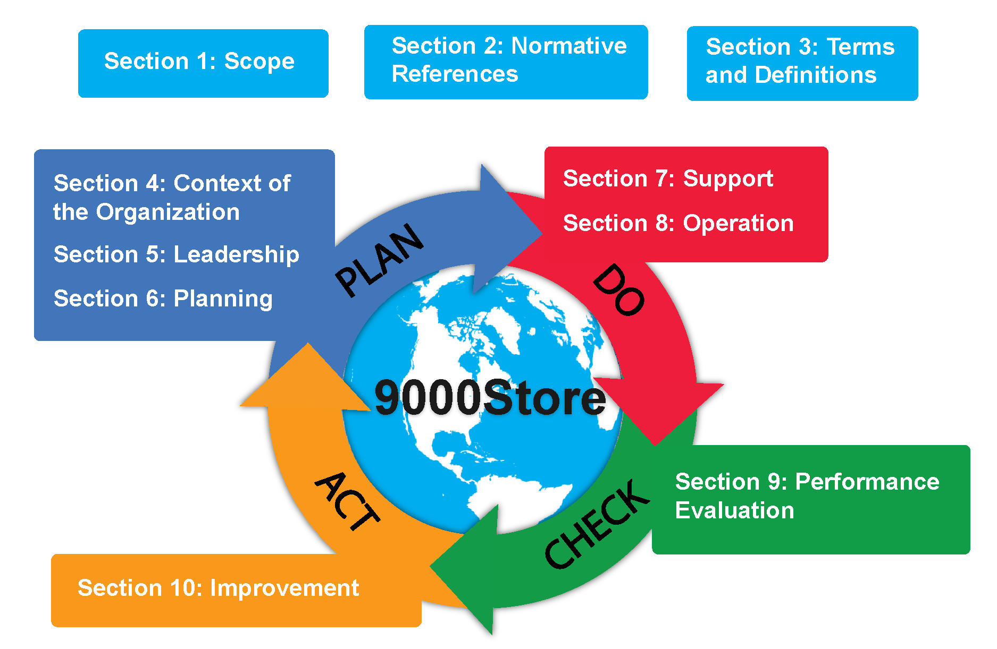
PDCA

Slide 7
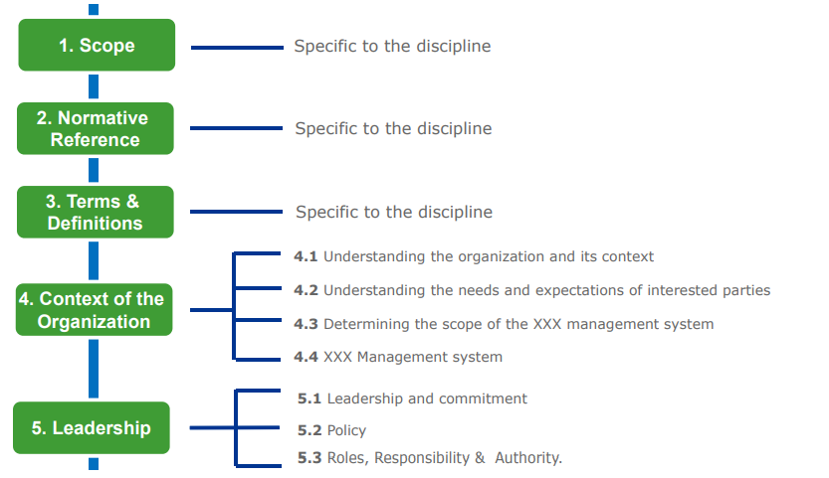
High Level Structure of ISO-50001

Slide 8
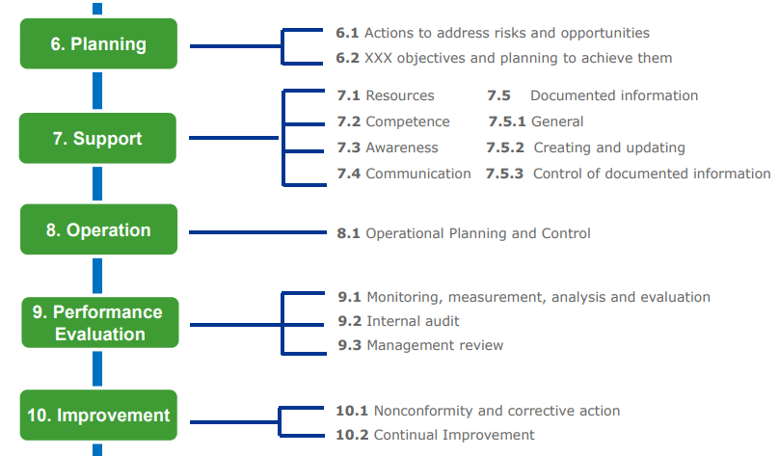

Slide 9
Clause 4: Context of the organization
4.1 Understanding the Organization and its context
4.4
Quality Management system
4. Context of the Organization
4.2
Understanding the needs and expectations of interested parties
4.3
Determining the scope of the quality management system

Slide 10
Clause 5: Leadership
5.1 Leadership & Commitment
5.2 Quality Policy
5.3 Organizational Roles , Responsibilities & Authorities

Slide 11
Clause 6. Planning
6.1 Actions to address risks & opportunities
Planning
6.3 Planning of changes
6.2 Quality objectives & planning to achieve

Slide 12
Clause 7: Support
7.1 resources
7.5 Documented Information
7.2 Competence
Support
7.4 communication
7.3 Awareness

Slide 13
Clause 8 : Operation
Operation
8.1 Operational planning and control
8.2 Requirements for products and services
8.3 Design and development of products and services
8.4 Control of externally provided processes , products and services
8.5 Production and service provision
8.6 Release of products and services
8.7 Control of nonconforming outputs

Slide 14
Clause 9: Performance evaluation
Performance Evaluation
9.1 Monitoring, measurement, analysis and evaluation
9.2 Internal Audit
9.3 Management Review

Slide 15
Clause 10: Continual Improvement
10.1 General
10.2 Nonconformity and corrective action
10.3
Continual improvements
Continual Improvement

Slide 16
Benefits of having an EnMS
Global recognition.
Improves energy performance
Optimizing energy cost and consumption.
Enables to cut down costs and improve profits.
Reduce carbon footprint.
Corporate Social Responsibility
Branding

Slide 17
011 2576616 , 0777 169339, 071 600 4411
info@winyana.com , sugath@winyana.com
No. 20, Kothalawala Avenue, Colombo 04.

